Slide 1


Energy Storage Shipboard Power System Fundamentals Revision of 2 February 2026
Dr. Norbert Doerry
http://doerry.org/norbert/MarineElectricalPowerSystems/index.htm
© 2026 by Norbert Doerry This work is licensed via: CC BY 4.0 (https://creativecommons.org/)

Slide 2
Essential Questions
What components can comprise an Energy Storage subsystem? | Remember
What functions can an energy storage subsystem provide? | Remember
What are the considerations for centralized vs decentralized energy storage? | Understand
How are the power and energy requirements for energy storage determined? | Apply

Slide 3
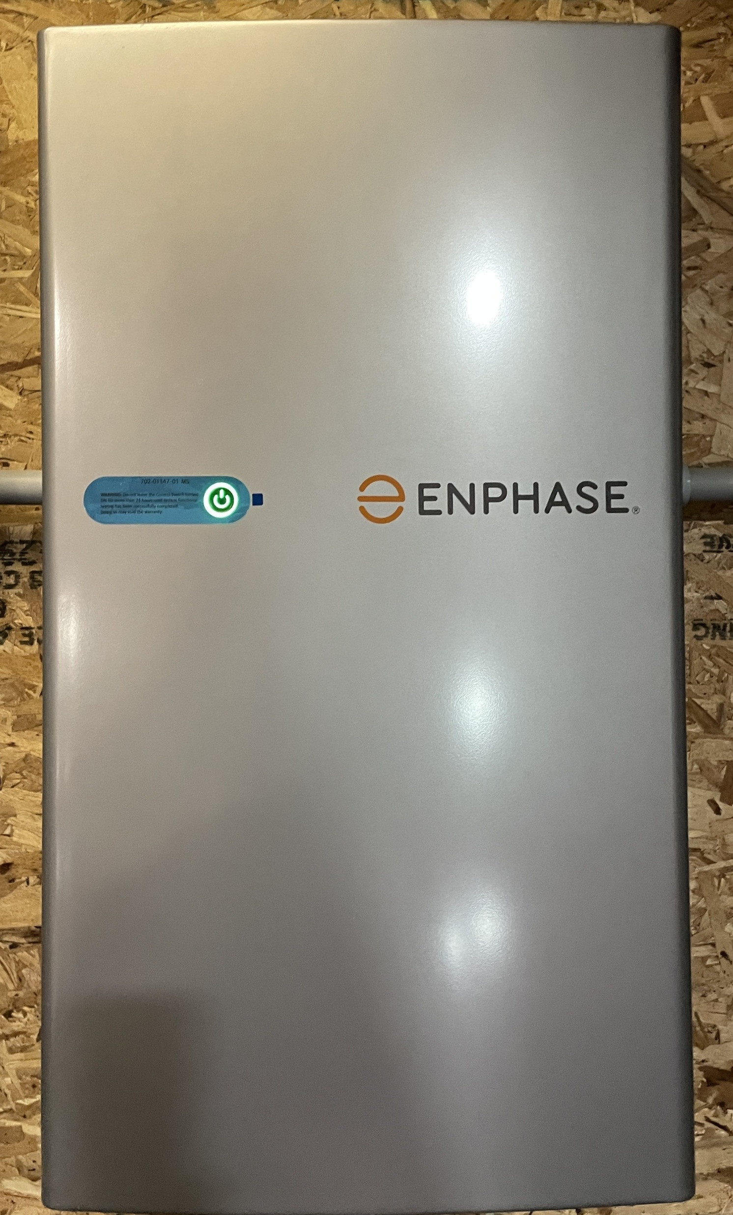
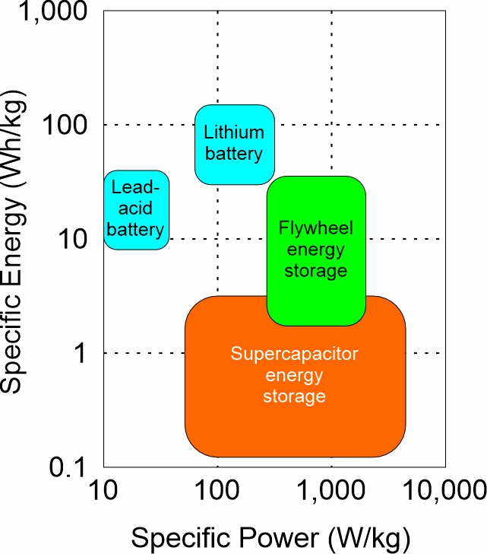
Possible components of an energy storage subsystem
Storge device
Batteries
Flywheels
Supercapacitors
Power electronic converters
Charging Converter
Discharging Converter
Power Conditioning
Transfer Switch

Slide 4
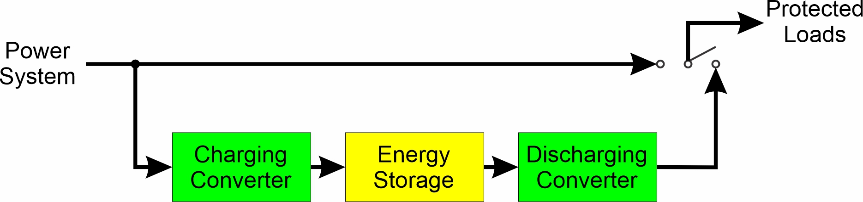
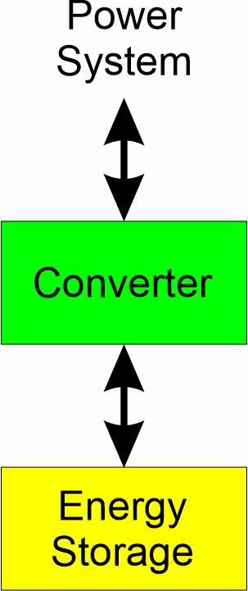
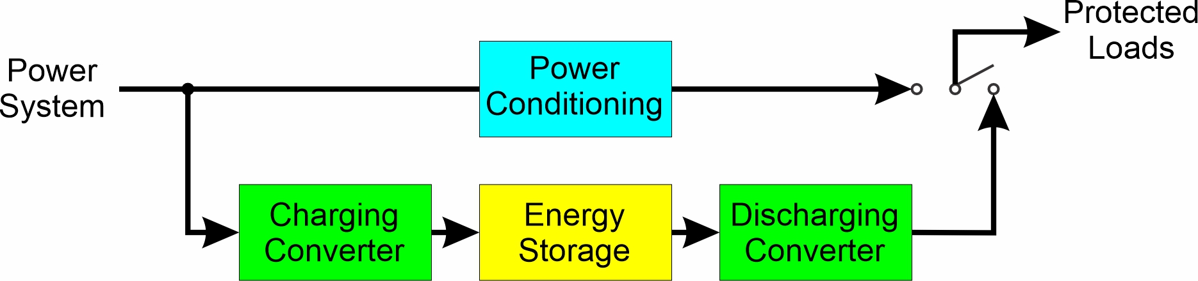
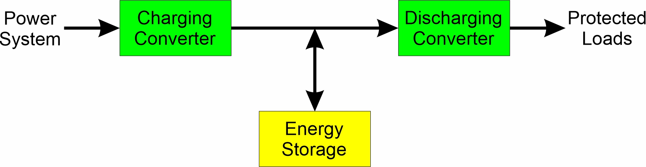
Energy storage system architectures
Standby UPS
Line-interactive UPS
Energy Storage System
Double conversion UPS

Slide 5
Definitions
Discharge and charge rates
C-Rate: 1C is charge/discharge rate corresponding to fully charging or discharging in one hour. 2C is twice the 1C rate and roughly corresponds to fully charging or discharging in ½ hour.
Charging and discharging may have different C-Rates.
Rated energy capacity
Amount of electrical energy that can be provided by energy storage when new and when discharging at a specified C-Rate.
State of charge (SOC)
Fraction of the rated energy capacity that the energy storage can provide. Fully charged has a SOC of 1.0; Fully discharged has a SOC of 0
State of health (SOH)
Fraction of the life remaining before energy storage has reached its end of life.
End of life is usually defined when the actual energy capacity has degraded to a specified (typically 80%) percentage of the rated energy capacity.

Slide 6
Definitions (continued)
Reconfiguration time (t1)
Maximum time to reconfigure the electrical distribution system or to clear faults without bringing on additional generation capacity.
Corresponds to the maximum time that a load could experience power quality outside of steady-state interface requirements due to circuit breakers clearing faults, or transients from circuit breakers changing the configuration of the electrical distribution system
Usually less than 2 seconds; depends on technology implemented in circuit breakers and other circuit protection components
Generator start time (t2)
Maximum time to bring the slowest standby generator set online
Usually between 10 seconds and 5 minutes.

Slide 7
Definitions (continued)
Zonal survivability
Zonal survivability is achieved if damage to one or two adjacent zones does not result in service interruptions in undamaged zones.
Compartment survivability
Compartment survivability incorporates provisions to quickly recover electrical power to undamaged critical loads in damaged zones that can be energized safely.

Slide 8
Energy Storage Functions
ESM-F1: Provide power of requisite power quality to loads during short term power disruptions of up to the reconfiguration time (t1).
ESM-F2: Provide power of requisite power quality to loads during power disruptions of up to the generator start time (t2).
ESM-F3: Provide power for the emergency starting of generator sets.
ESM-F4: Provide load leveling for pulsed loads, generator sets with slow dynamics, and generator sets operating near their capacity.
ESM-F5: Provide primary power with or without other generator sets online.

Slide 9
Centralized vs Decentralized energy storage
Centralized Energy Storage
Generally connected to the main power generation and distribution bus.
Serves many loads.
Can fulfill ESM-F2, ESM-F4, ESM-F5, and possibly ESM-F3.
Usually configured as an energy storage system.
Decentralized Energy Storage
Serves only a few loads.
Can fulfill ESM-F1, ESM-F2, ESM-F3 and some applications of ESM-F4.
Usually configured as an UPS.

Slide 10
Determining Energy Storage Requirements: Types of studies
UPS vs fast circuit breaker studies (ESM F-1)
Trade-off use of UPS with slow circuit breakers against use of fast circuit breakers with minimal UPS.
Standby generator start simulations (ESM F-2)
Trade-off centralized energy storage with decentralized energy storage to provide power to loads after a generator set trips offline and before the standby generator comes online.
Reserve power studies (ESM F-2)
Study examines use of energy storage for cases where load exceeds online generation capacity and additional generation has not yet come online.
Dark ship start simulation (ESM F-2 and ESM F-3)
Determines if the system is capable of restarting following loss of all online generator sets, but before energy storage is depleted.

Slide 11
Determining Energy Storage Requirements: Types of studies (continued)
Load-leveling study (ESM-F4)
Examines support of sources (such as fuel cells) that are not capable of fast enough dynamic response to achieve power quality requirements.
Examines the benefit of enabling generator sets to operate near their power rating by providing power when the load temporarily exceeds generator set rated power.
Examines compensating for pulsed loads by providing the deviation (either sourcing or sinking) around the average power for the pulsed load.
Zonal and compartment survivability analysis (ESM-F5)
Examines sufficiency of energy storage to achieve zonal and compartment survivability
Endurance energy calculations (ESM-F5)
Calculated required power and energy of energy storage to achieve a specified endurance requirement.
Based on a variation of the methods in DPC 200-1 for calculation the endurance fuel requirements for a ship.

